Slide 1

Introduction:
Process Cleaning for Healthy Schools™

Slide 2
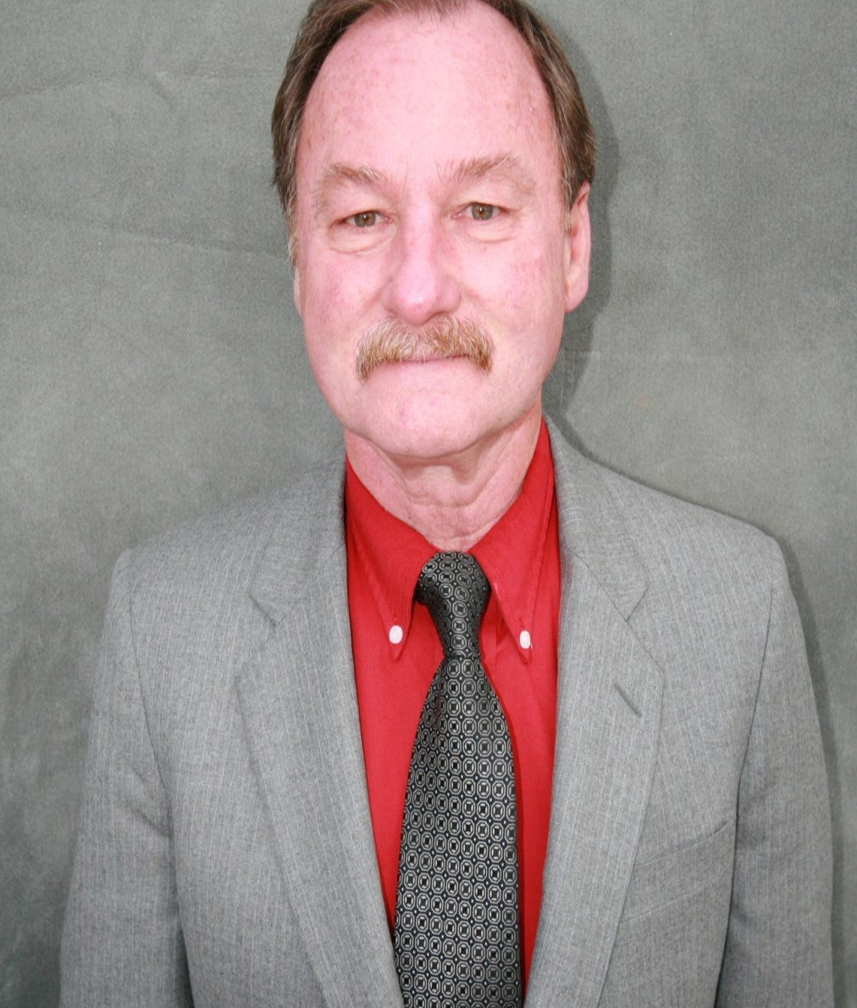
Rex Morrison
Founder
Process Cleaning For Healthy Schools Consortium President
Washoe County Schools Custodial
Field Supervisor - Retired

Slide 3
State of Nevada Employee of the year
2004 ISSA Custodial Supervisor of the year
2006 Cashmen Good Government Award
Washoe County School District - Outstanding Employee

Slide 4
Process Cleaning for Healthy Schools “PCHS” is built upon a combination of specialization and new technology.
High Tech !

Slide 5
PCHS Is a management based cleaning system set in a K-12 environment with emphasis on cleaning student and staff spaces for health.

Slide 6
A non-profit (501c3) consortium made up of school employees helping other school employees. “Schools Helping Schools.”
PCHS Consortium President,
Rex Morrison

Slide 7
PCHS… A history :
It starts with you … asking yourself a few simple questions …

Slide 8

Does my school district have a set standard for cleaning classrooms and restrooms?
Is every custodian in every school cleaning a classroom and a restroom the same way using the same simple steps achieving the same average times?

Slide 9

Is there a management system in place at my school district that holds every custodian accountable?
Accountability !!!!!

Slide 10

When I was a custodial field supervisor for Washoe County School District
-100 schools, 450 custodians.
We had 450 ways we cleaned a classroom and 450 ways we cleaned a restroom.

Slide 11
Chaos & confusion !!
Two forms of Management …
Yes …N0!
YES! …
NO!
Maybe…?

Slide 12
Is there a simple documentation process to ensure daily custodial accountability?
Are the students, teachers and staff receiving the highest level of cleanliness at the lowest level of cost?
?
Dusting
??
?
Vacuum
??
?
Mop
??

Slide 13
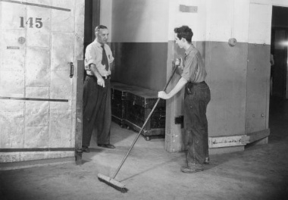
Complaint driven

Slide 14

Quality driven
GREAT JOB !

Slide 15
If you clean for health … appearance will follow.
YOU deserve a RAISE!

Slide 16
The PCHS Value

Slide 17
The alternative to privatization, outsourcing and broken budgets is doing more with less.

Slide 18
The average square footage a custodian can clean set by the ISSA and other staffing studies is 22,000 Sq. Ft.

Slide 19
PCHS brings that number to an average of 27,000 sq. ft. to 30,000 sq. ft.
In some schools with minimal budget it was 45,000 sq. ft. without sacrificing cleaning for health.
Higher
Productivity

Slide 20
The Nuts and Bolts of Process Cleaning for Healthy Schools?

Slide 21
Process cleaning is the study of time and motion applied to cleaning a classroom or restroom. These same principles can be applied to convalescent homes, cruise ships, airplanes and the hotel industry.

Slide 22

Tasks are stacked like a row of dominos and every cleaning function builds into the next or future cleaning responsibility.

Slide 23

By following the principles of time, motion and applying them to a K-12 environment with a few minor twists and turns I was able to set up a cleaning program that really works. It starts by training the trainer on how to perform PCHS.

Slide 24
To break it down into its simplest form: Process cleaning is divided into just a few cleaning tasks or functions…
Just
A FEW
Tasks?
Wow!

Slide 25
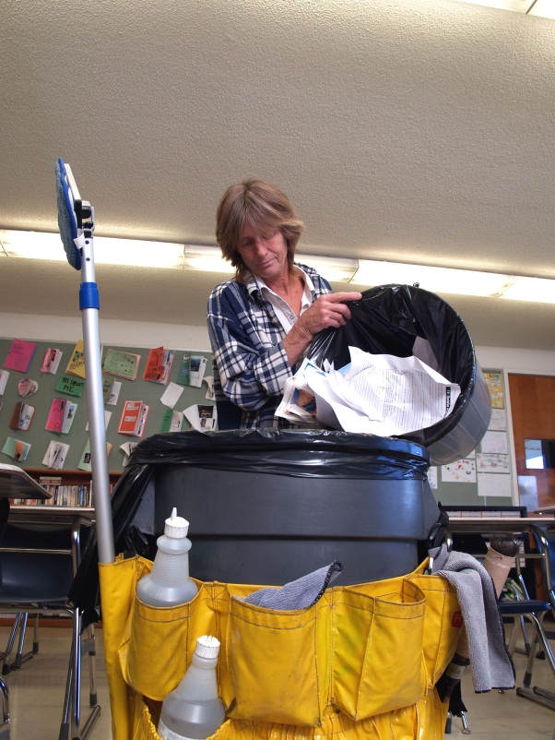
Primary
Cleaning Classrooms

Slide 26
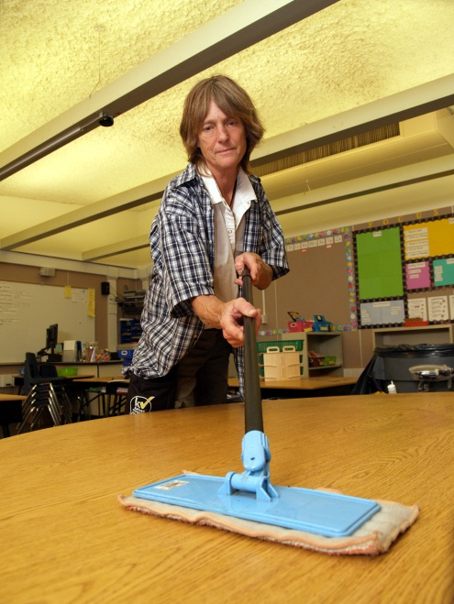
Lock door, clean door glass, disinfect door handles, light switch and phone. Disinfect all desktops, check all soap, paper (write it down) clean sink and countertop.
PRIMARY

Slide 27
Empty trash & pencil sharpener. (Pick up any large item a backpack vacuum wont suck up. Clean whiteboards & blackboards. Dust the room if it falls within your designated deep cleaning area.
PRIMARY
Done – whoop whoop!

Slide 28
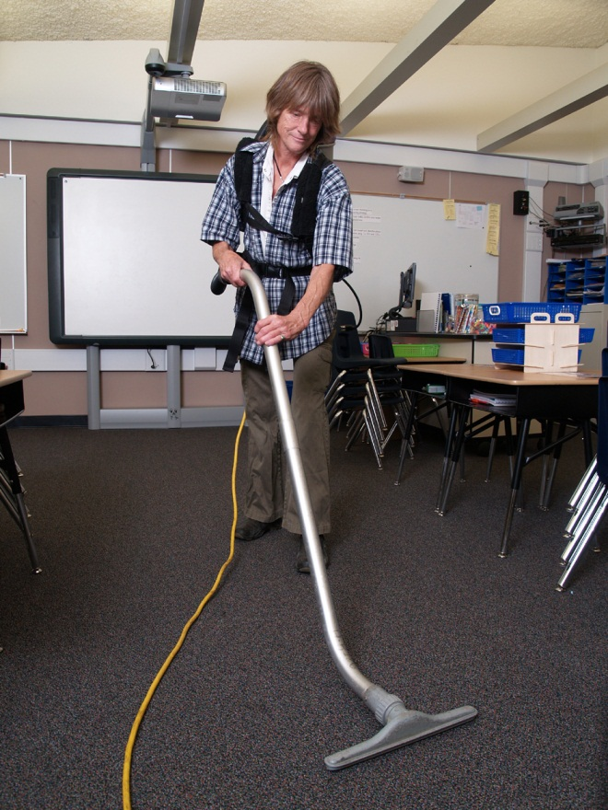
Vacuum all classrooms using a backpack vacuum following the loop vacuum method. 5 minutes
PER ROOM.
SECONDARY

Slide 29
Sanitation Process:
Use a spray and vacuum restroom cleaning machine and clean all your restrooms for health.
SANITATION
No Rags
No
Chemicals
How green can you get?

Slide 30
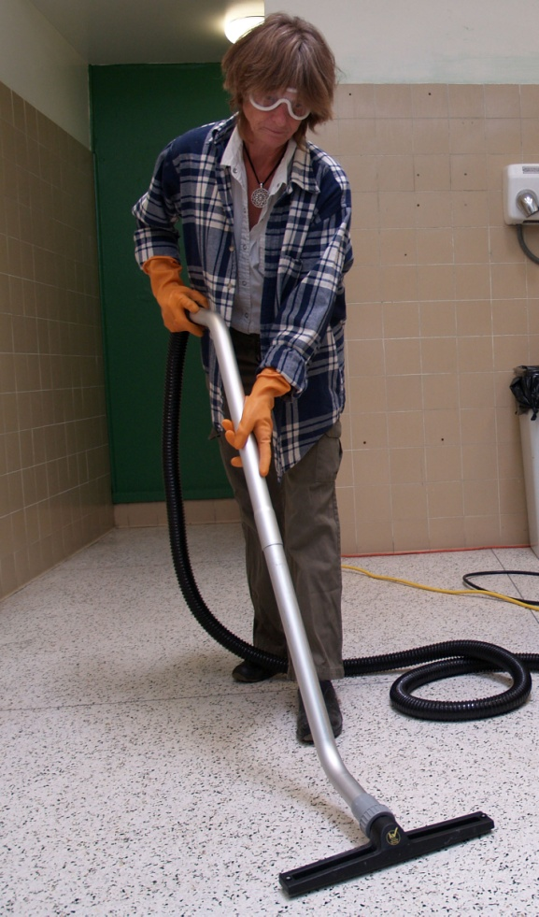
A Green way to clean

Slide 31
Stage two - PCHS The Concept:
Process Cleaning for Healthy Schools 12 day Implementation Program.
The Perfect
Rx for
Positive change

Slide 32
Day 1&2
Perform a walkthrough of each school to assess and analyze your staffing needs per school based upon the implementation of Process Cleaning for Healthy Schools.

Slide 33
Five days of training the trainer…
Five days of setting up PCHS at a prototype school of your choice…
After-care follow up…

Slide 34
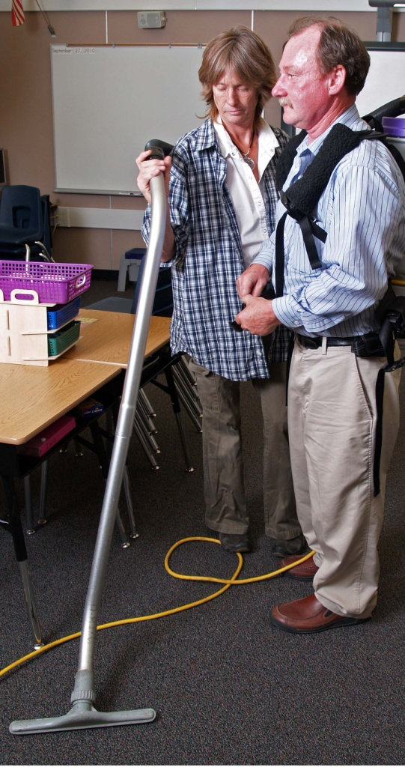
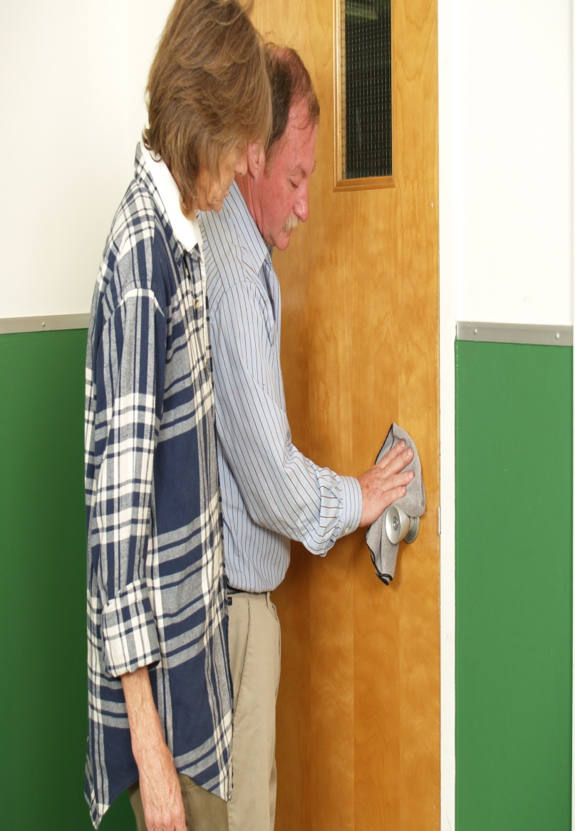
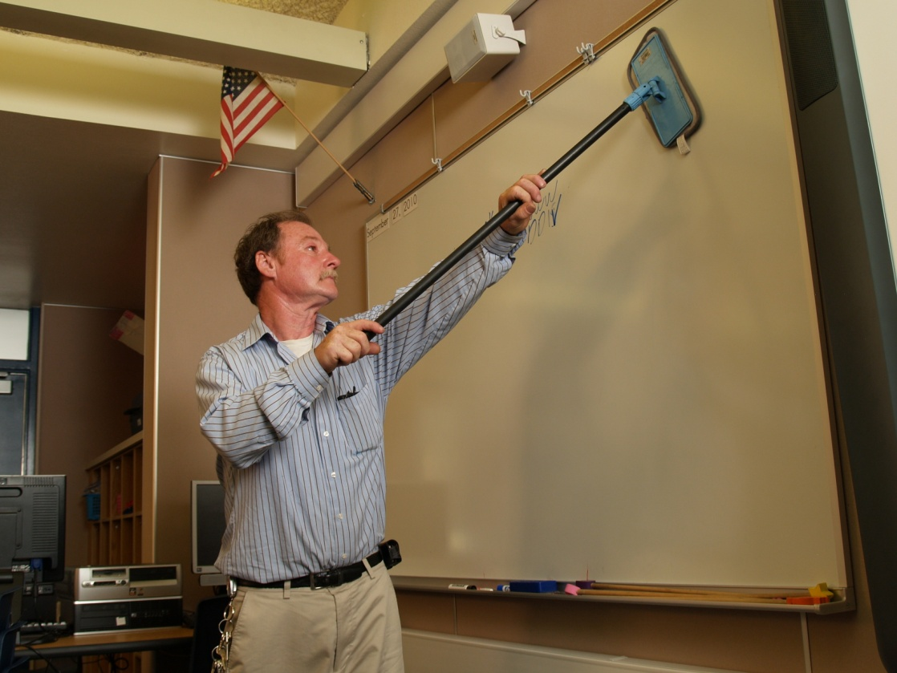
Hands on Training

Slide 35
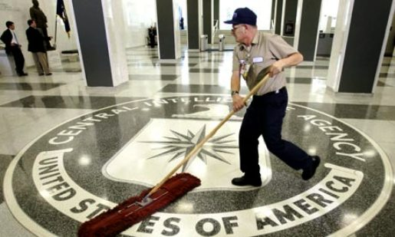
Training the trainer makes sense

Slide 36

How I started… ten years ago as a head custodian at an elementary school I began developing a program that took me out of the dark ages of cleaning into a new and exciting age of developing cleaning processes for health. It is based upon scientific testing and evaluation.
Our staff-
Circa 2000

Slide 37
My challenge was to take a system designed around a ten story office building and make it fit a school environment, using the most modern tools and techniques.

Slide 38
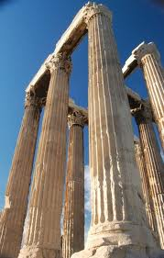
The five pillars of PCHS

Slide 39

What Puts the Green into Green Cleaning ?

Slide 40
#1 It’s made with plant based – biodegradable cleaning ingredients

Slide 41
#2 Cleans with no harsh chemical fumes or residue

Slide 42
#3 NEVER tested on animals

Slide 43
1.Green- because it is the right thing to do.
2.Micro fiber- because it works!

Slide 44
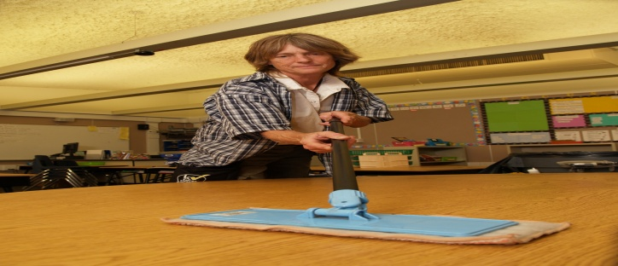
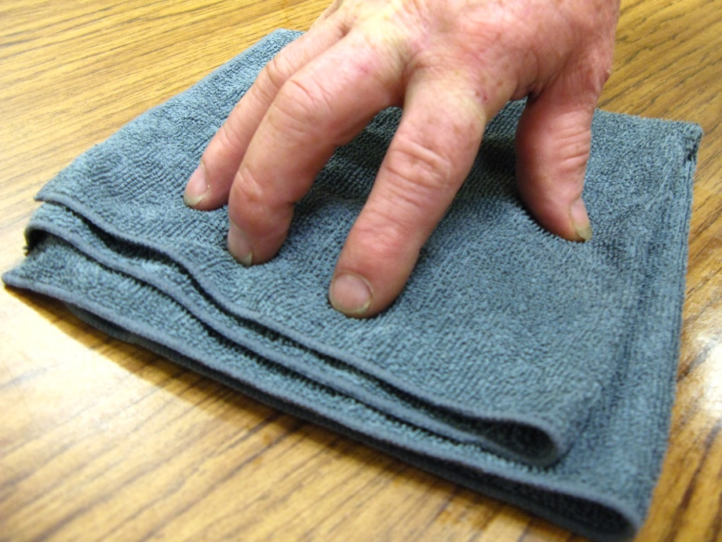
Micro Fiber makes it happen !

Slide 45
3. Backpack suction vacuuming technology.
50%-80 % faster and it changed the cleaning industry.

Slide 46
Backpack
No-Nonsense
High Tech

Slide 47
4. Spray and vacuum restroom cleaning 50% faster, cleaning healthier. It is changing the cleaning industry.

Slide 48
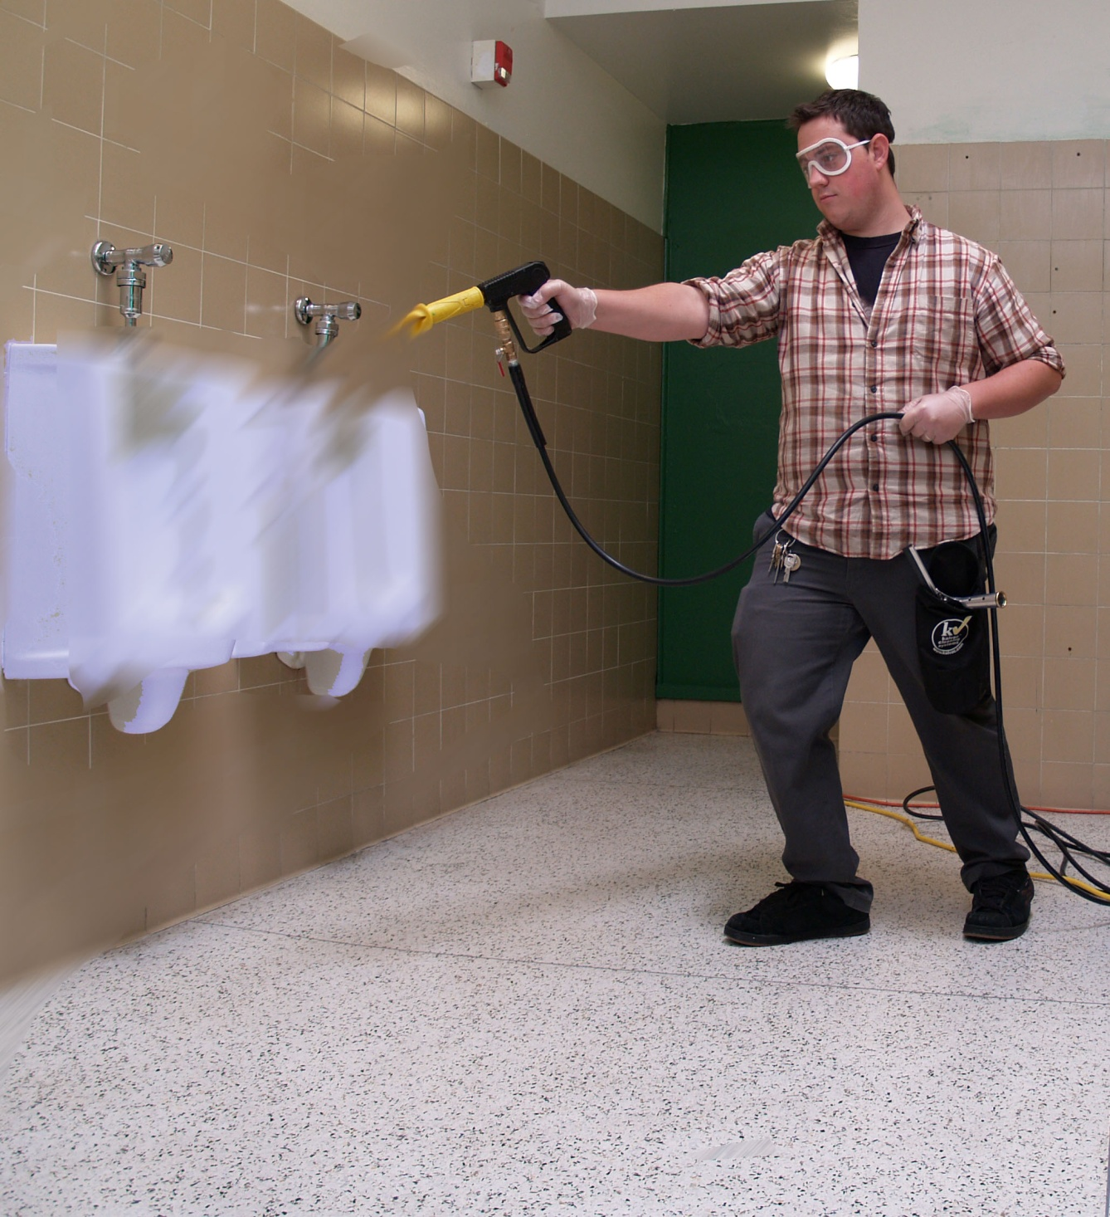

Slide 49
5. ICM – ATP testing- now we can use science to back up what we say.

Slide 50
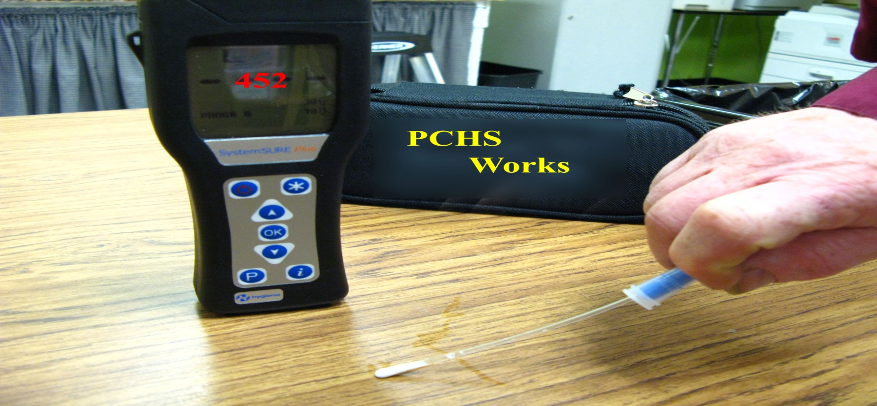
Cutting edge technology

Slide 51
The PCHS VALUE

Slide 52
The alternative to privatization, outsourcing and broken budgets is doing more with less…

Slide 53

Today many schools are STUCK in the dark ages of cleaning.
OH
NO!

Slide 54
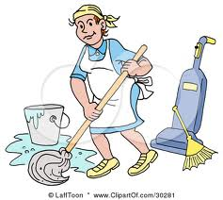
They are fifty years behind the technical curve.
Process Cleaning for Healthy Schools will help you step into a new and exciting age of specialization, systems application, technical advancement and scientific measurement.

Slide 55
The result … cleaner, more germ-free student and staff spaces at a savings to the tax payer.

Slide 56

Thank you !
Rex Morrison rex.morrison1@gmail.com

